Slide 1
Advanced Understanding of Statistical Models for ML
Kevin Ford
kevinf@magenic.com
617 359-5192

Slide 2
https://github.com/Magenic/MMLStatisticalModelsForML
https://www.amazon.com/Machine-Learning-Absolute-Beginners-Introduction-ebook/dp/B07335JNW1?ie=UTF8&redirect=true&ref_=ku_mi_rw_edp

Slide 4
Feedforward Neural Network
Data moves in one direction
This deals with the architecture, not the training
There may be back propagation in training but in execution data only moves “forward”
Contains one or more layers
Is the “simple” network type we have been dealing with

Slide 5
Demo 1: Feedforward Neural Network

Slide 6
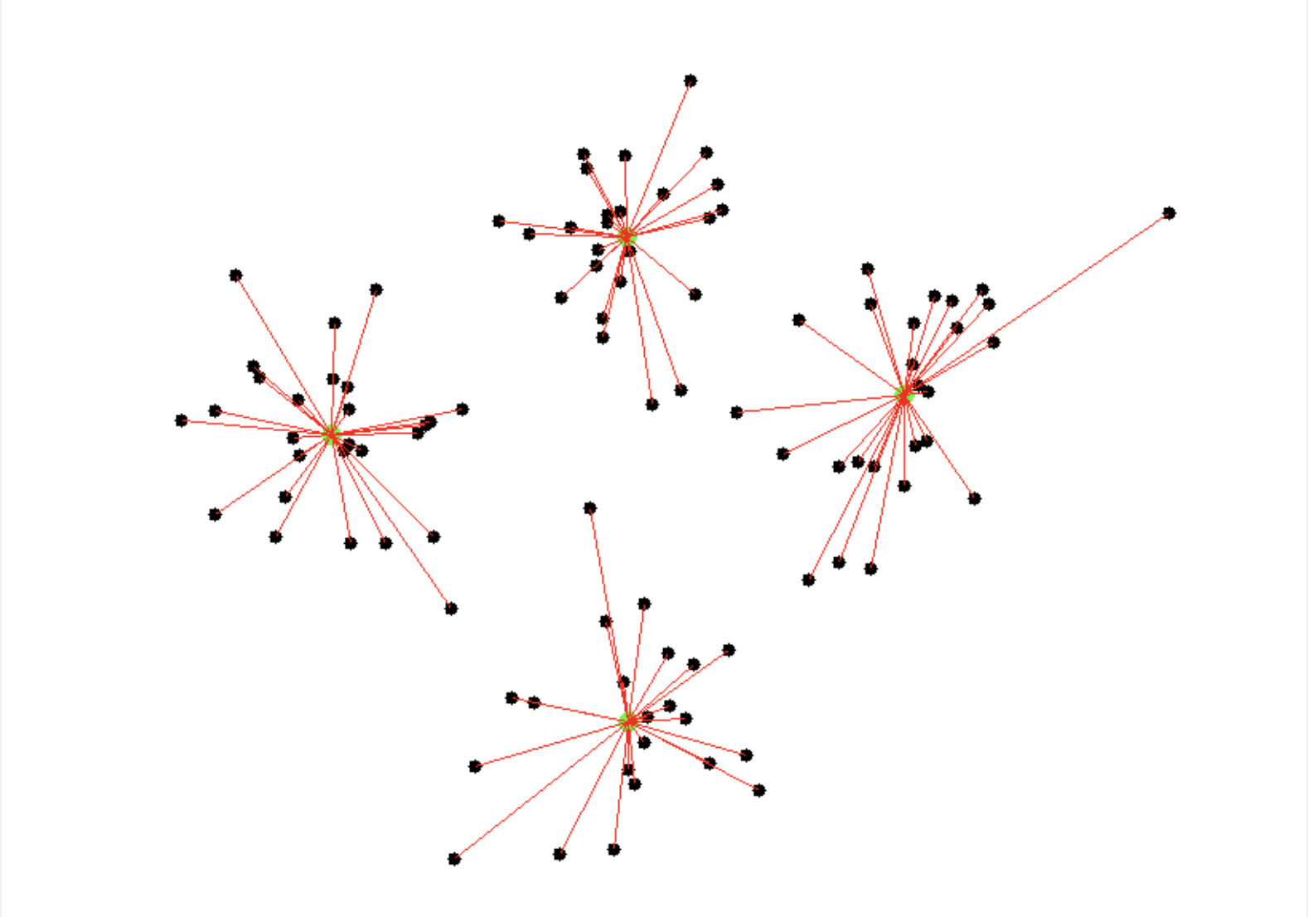
Radial Basis Function Neural Network
A radial basis function is any function which is defined as a function of distance from a certain central point (a radius).
Network measures distances to central points
Normal structure input layer -> RBF layer -> output layer
No official support in TensorFlow
Converting data to Z-Score helps with training

Slide 7
Demo 2: Radial Basis Function Neural Network

Slide 8
Convolutional Neural Network
Summarizes groups of adjacent information and may capture features of the image
Groups may overlap with other groups
Summary information can then be used to train the model in a way that preserves special information
Convolution – The treatment of a matrix by a second matrix as a filter/aggregator

Slide 9
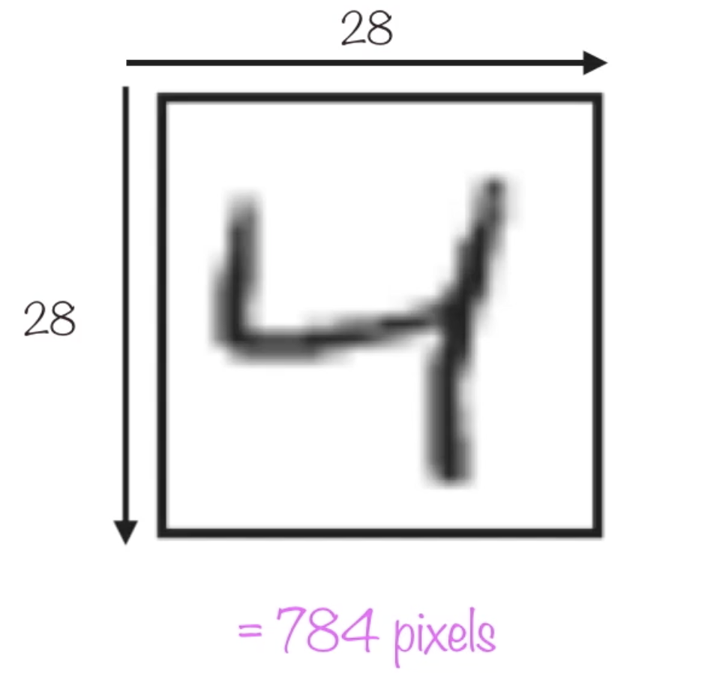
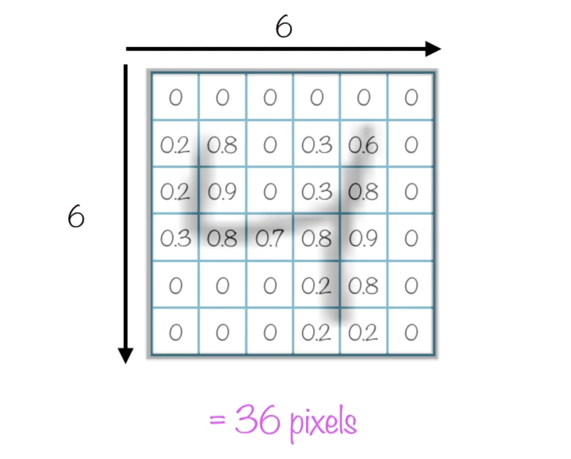
Convolution
Matrix of pixels
Submatrix

Slide 10
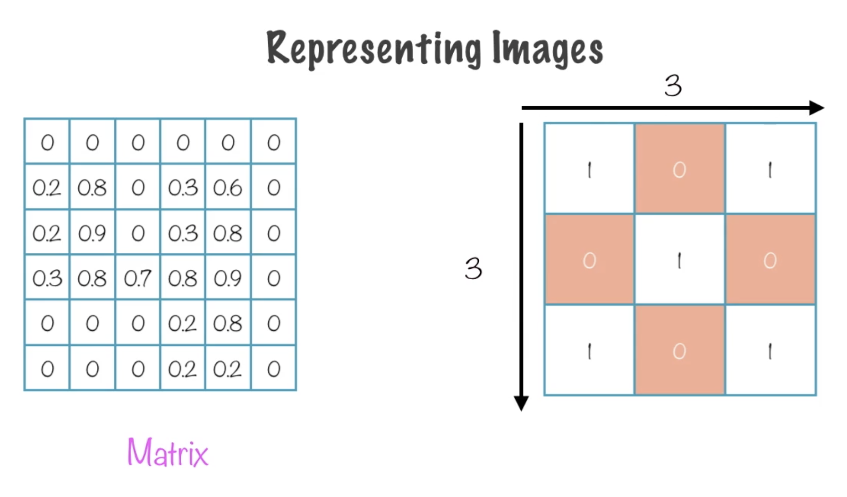
Convolution
Submatrix of pixels
Kernel
Kernel size

Slide 11
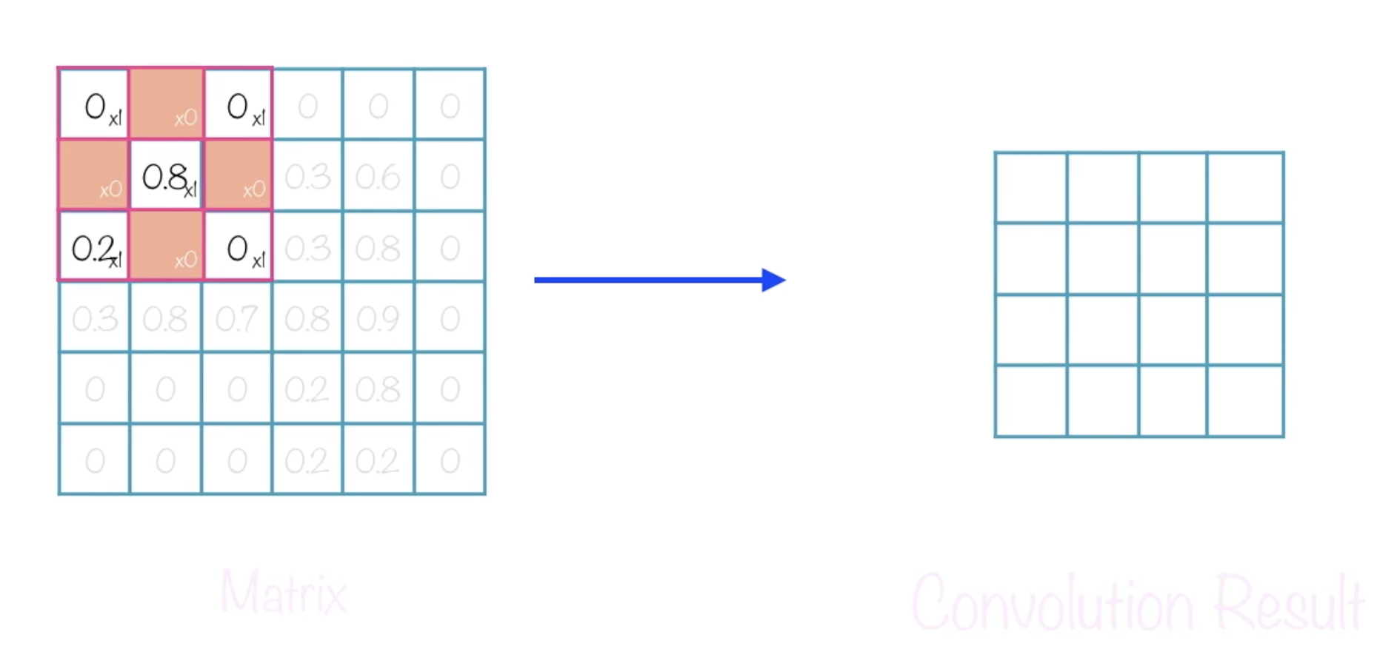
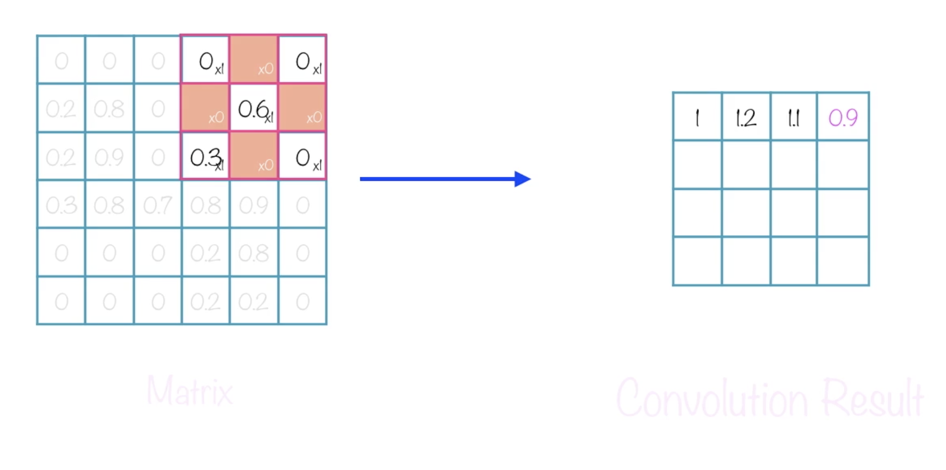
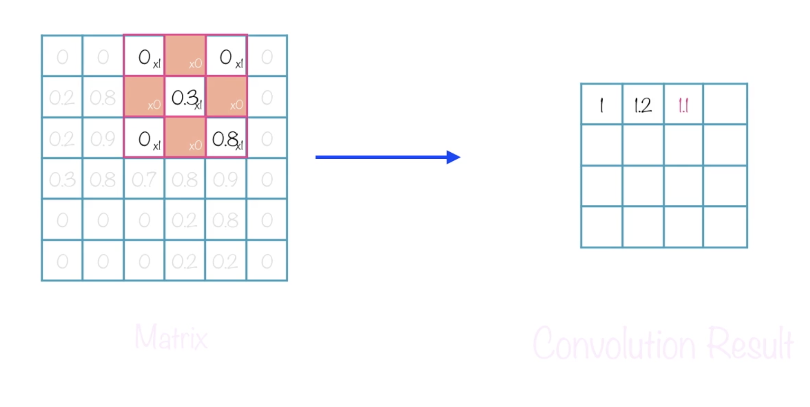
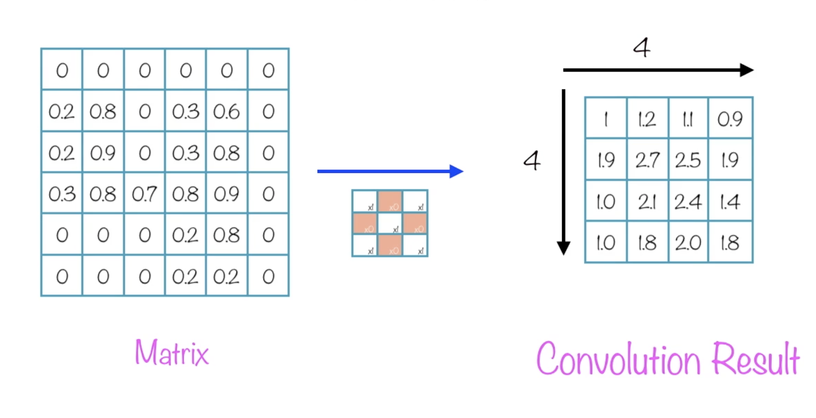
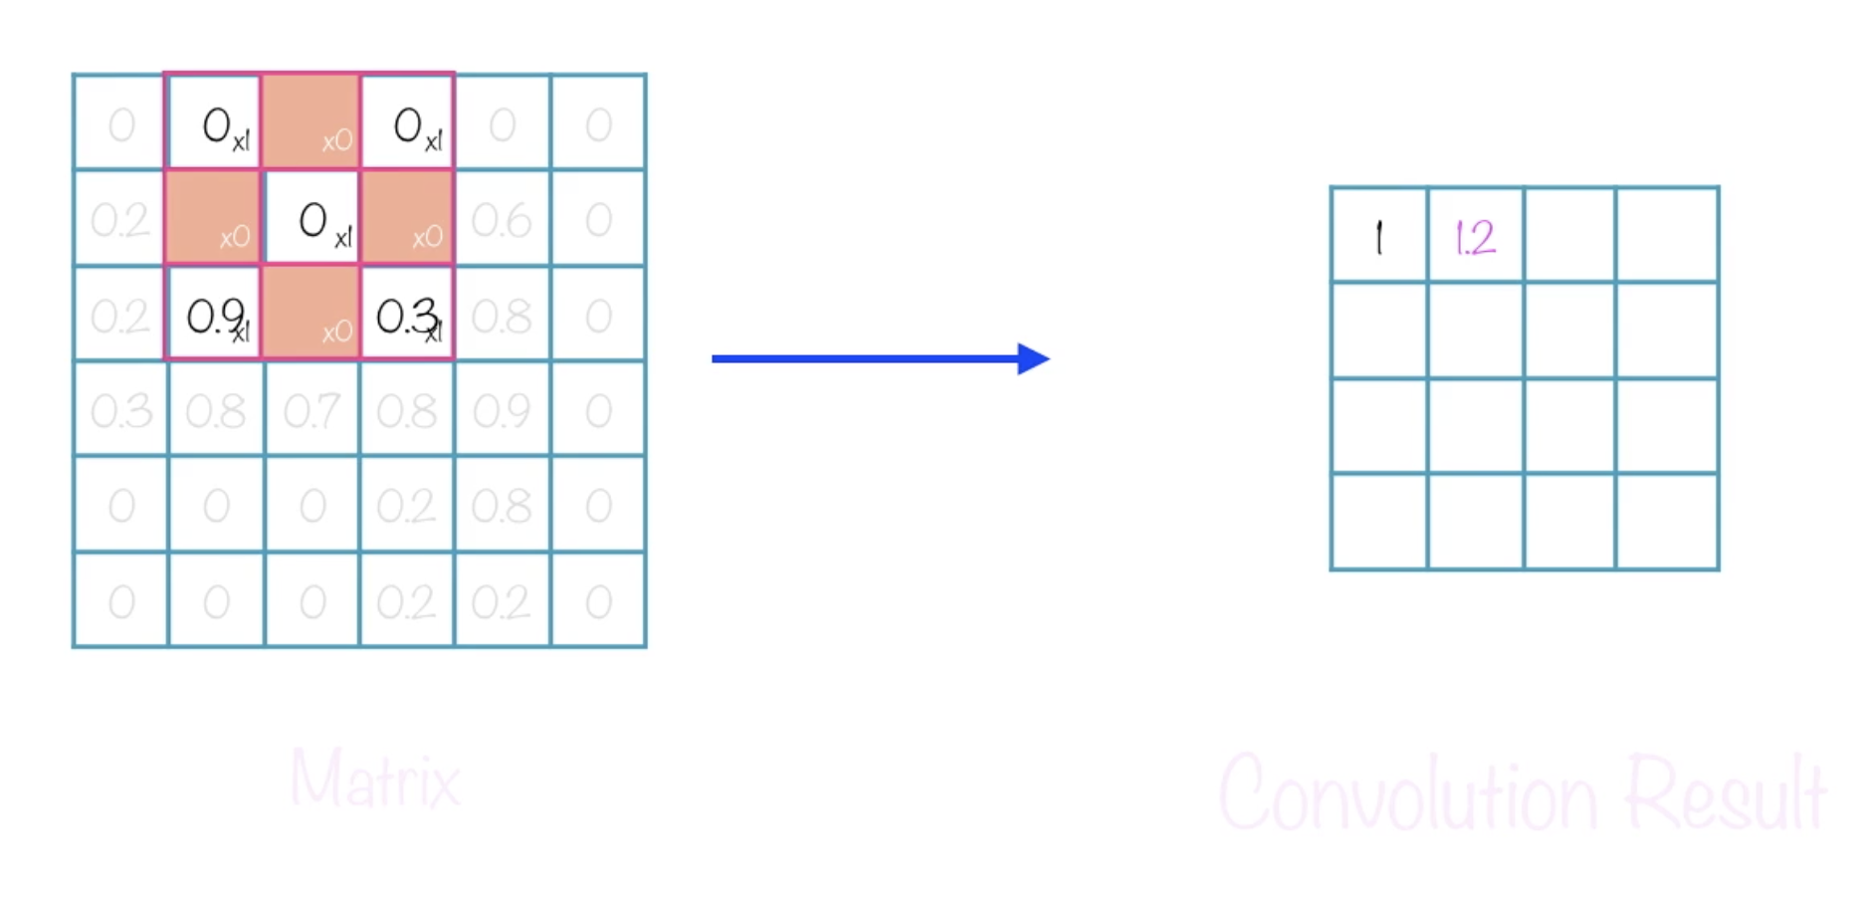
Convolution
Submatrix (4x4)
Local receptive field Neuron
This shows a stride length = 1, i.e. the kernel is moving one position at a time across the matrix for a stride of (4x4)
Borders with can be added to get edge data using 0 values, this is called padding
Notes:
Moving a filter across the image
Finite number of convolutions as filters make the images “smaller”

Slide 12
Convolution
Matrix of pixels
Kernel: ?
Stride: ?
Padding: ?
Submatrix
Notes:
Kernel size 8, stride 4, padding 0
Kernel size 5, stride 5 , padding 1

Slide 13
Creating a convolution in Tensorflow
Each convolution requires to lines to be added to the model
model.add(keras.layers.Convolution2D({number of filters}, ({x,y kernel size}), padding={'valid' or 'same'}, strides=({x,y stride size}), activation='relu'))
model.add(keras.layers.MaxPooling2D(pool_size=(x,x pool size), strides=(x,y strinde size)))
A pooling layer is used for ordering layers within a convolutional neural network that may be repeated one or more times in a given model.
Reduces the size of the features to more generalized ideas
Padding of 'same' pads the image with 0s to retain the same size
A ‘flatten’ layer converts the special representation back to normal tensor shapes
model.add(keras.layers.Flatten())

Slide 14
Demo 3: Convolutional Neural Network

Slide 15
Recurrent Neural Network (RNN)
Output of a layer is saved and fed back into the input
Each node in an RNN layer feeds back into the input
Long Short Term Memory - LSTM
Allows previous answers to be “reused”
Very useful in scenarios where a => b
Schematically, a RNN layer uses a for loop to iterate over the timesteps of a sequence, while maintaining an internal state that encodes information about the timesteps it has seen so far.

Slide 16
RNN in Tensorflow
Special LSTM Layer
model.add(LSTM(output_shape, input_shape=input_shape))
Common Uses
Time Series Predictions
Text Classification
SimpleRNN Layer
GRU Layer

Slide 17
Bi-Directional RNNs
For sequences other than time series (e.g. text), it is often the case that a RNN model can perform better if it not only processes sequence from start to end, but also backwards. For example, to predict the next word in a sentence, it is often useful to have the context around the word, not only just the words that come before it.
model = keras.Sequential() model.add( layers.Bidirectional(layers.LSTM(64, return_sequences=True), input_shape=(5, 10)) ) model.add(layers.Bidirectional(layers.LSTM(32))) model.add(layers.Dense(10)) model.summary()
The output of the Bidirectional RNN will be, by default, the sum of the forward layer output and the backward layer output.

Slide 18
Demo 4: Recurrent Neural Network (RNN)

Slide 19
Modular Neural Network
A collection of neural networks
Combination of networks complete the task
Keeps individual models focused on a single task
Training simpler
More CPU efficient
Usually a coordination model or logic

Slide 20
Demo 5: Modular Neural Network

Slide 21
Sequence-To-Sequence Models
Uses two Recurrent Neural Networks
Encoder = Processes input
Works well where input and output are not the same shape
Decoder = Processes output
Used for:
Chatbots
Machine Translation
Q & A

Slide 22
Sequence-To-Sequence

Slide 23
Demo 6: Sequence-To-Sequence Models

Slide 24
Homework reading
Book Chapters 16-22, 37-38
https://www.digitalvidya.com/blog/types-of-neural-networks/
https://www.javatpoint.com/single-layer-perceptron-in-tensorflow
https://towardsdatascience.com/most-effective-way-to-implement-radial-basis-function-neural-network-for-classification-problem-33c467803319
https://stackoverflow.com/questions/53855941/how-to-implement-rbf-activation-function-in-keras/53867101#53867101
https://towardsdatascience.com/recurrent-neural-networks-56e1ad215339
https://medium.com/@ilblackdragon/tensorflow-sequence-to-sequence-3d9d2e238084
https://www.tensorflow.org/tutorials/text/nmt_with_attention

Slide 25
Homework assignment
Experiment with different model structures. Why would you use one over another?

Slide 26
Q & A
New week – Polishing it off

